Slide 1

Final Exam Presentation on Airline Management System
Name: Nupur
NUID: 001357340

Slide 2
ERD>>
Airline Management Service

Slide 3
Set 1: Create DB, creates tables, create sample records/values/tuples, USE, and Drop DB
A database schema is the skeleton that represents logical view of the entire database.
The CREATE DATABASE statement is used to create a database in MySQL
Create, Use and Drop DB:

Slide 4
Creating Tables
Creating table syntax:
CREATE TABLE statement is used to create a table in a database.
Inserting values into the tables:
Syntax for inserting values:

Slide 5
Inserting Values

Slide 6
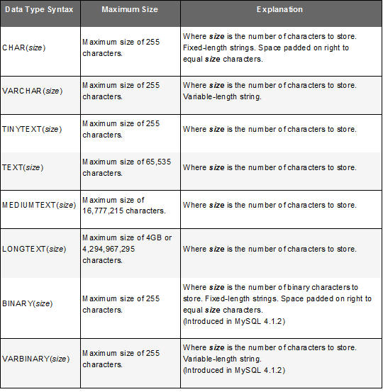
Set 2: Use DB, create tables with table options (NULL, Key, etc.), data types, insert, index and set Use DB:
TABLE OPTION:
NOT NULL - Ensures that a column cannot have a NULL value
UNIQUE - Ensures that all values in a column are different
PRIMARY KEY - A combination of a NOT NULL and UNIQUE. Uniquely identifies each row in a table
FOREIGN KEY - Uniquely identifies a row/record in another table
CHECK - Ensures that all values in a column satisfies a specific condition
DEFAULT - Sets a default value for a column when no value is specified
INDEX - Used to create and retrieve data from the database very quickly
Data Types:

Slide 7
Set 3: Select – From – Where – Group By – Having - Order By – Limit

Slide 8
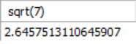
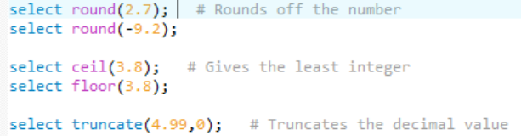
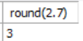
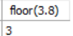
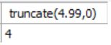
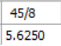
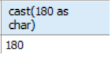
Set 4: Select 10 functions in SQL statement of your choice (including but not limited to Comparison, control flow, cast, string, numeric, date/time manipulation, calculation, conversion, aggregate functions, etc.)

Slide 9
Set 5: Perform JOIN operation including INNER JOIN, LEFT JOIN, RIGHT JOIN, FULL JOIN, CROSS JOIN operations and display the sample result using SELECT statement
INNER JOIN
Creates a new result table by combining column values of two tables (table1 and table2) based upon the join-predicate.
LEFT JOIN
The LEFT JOIN keyword returns all records from the left table (table1), and the matched records from the right table (table2). The result is NULL from the right side, if there is no match.

Slide 10
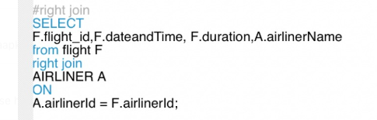
RIGHT JOIN
The RIGHT JOIN keyword returns all records from the right table (table2), and the matched records from the left table (table1).
CROSS JOIN
The SQL CROSS JOIN produces a result set which is the number of rows
in the first table multiplied by the number of rows in the second table
if no WHERE clause is used along with CROSS JOIN.

Slide 11
Set 6: Perform Queries and Sub-queries operations and display the result using SELECT statement
Queries:

Slide 12
SUBQUERIES:

Slide 13
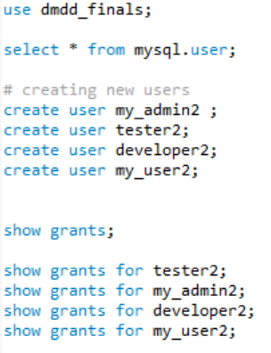
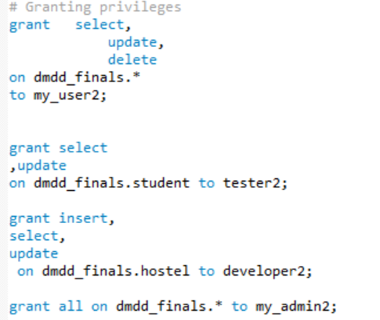
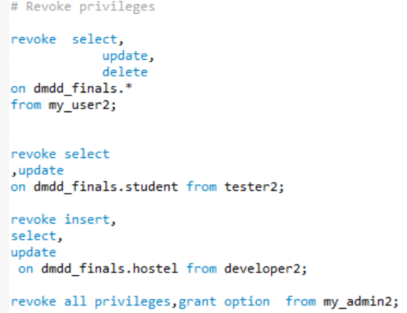
Set 7: Create four different users (Admin, Tester, Developer and User) with different privilege settings and display access differentiation among four users. Use GRANT and REVOKE command to give/remove additional access/rights to DB.

Slide 14
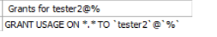
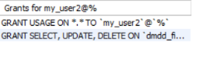
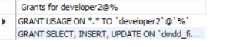
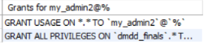
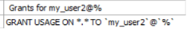
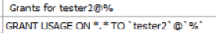
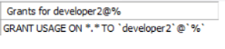
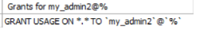
Result:

Slide 15
Set 8: Create two examples of STORED PROCEDURE and display the results.
Stored Procedures:
A stored procedure is a prepared SQL code that you can save, so the code can be reused over and over again.
So if you have an SQL query that you write over and over again, save it as a stored procedure, and then just call it to execute it.
You can also pass parameters to a stored procedure, so that the stored procedure can act based on the parameter value(s) that is passed.
EXAMPLE 1:

Slide 16
EXAMPLE 2:

Slide 17
Set 9: Perform COMMIT and ROLLBACK operations with SAVEPOINT/ROLLBACK TO SAVEPOINT. Include the use of LOCK/UNLOCK Table operations. Display result of each operation.
COMMIT – Statement used to terminate a transaction and to save all changes made by the transaction to the database.
ROLLBACK – Statement allows to rollback a transaction to a predetermined marker (savepoint)
SAVEPOINT – defines a marker in transaction

Slide 18
Set 10: Perform Triggers operations using INSERT, UPDATE, DELETE and display result
A trigger is a named database object that is associated with a table, and that activates when a particular event occurs for the table.
A trigger is defined to activate when a statement inserts, updates, or deletes rows in the associated table.

Slide 19
BACKUP PLAN
Night | Backup Type
Monday | Incremental from Saturday
Tuesday | Incremental from Saturday
Wednesday | Incremental from Saturday
Thursday | Incremental from Wednesday
Friday | Incremental from Wednesday
Saturday | Full
Sunday | Incremental from Saturday
The hostel management service is most busy on Monday. However the management is free on the weekends. Another incremental backup is taken mid-week when the management is not busy with student services. Hence we take full backup on Saturday and incremental backup from Saturday to Wednesday.

Slide 20
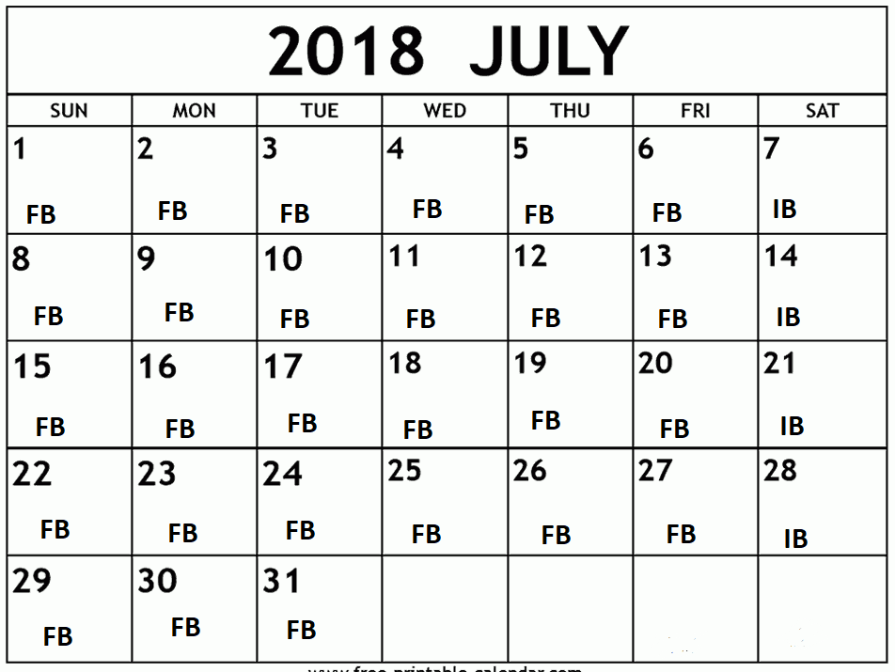
Sample monthly calendar (say 30 day) with FB for Full Backup and IB for Incremental Backup

Slide 21

THANK YOU

